Slide 1
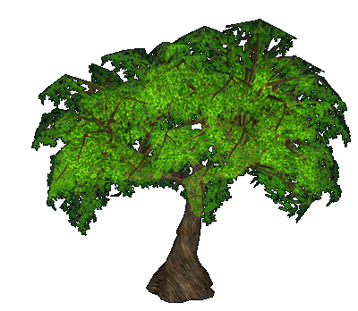
DATA SCIENCE
DECISION TREE & SVM
(UNIT 3)
SIKKIM UNIVERSITY
MCA,3RD SEMESTER
-PRATIKSHYA SHARMA

Slide 2
CONTENT
DECISION RULES
ATTRIBUTE SELECTION MEASURES
INFORMATION GAIN
GINI INDEX
ID3
DISTANCE BASED CLASSIFICATION
SIMPLE APPROACH
NEAREST NEIGHBOUR CLASSIFIER
SUPPORT VECTOR MACHINE

Slide 3
DECISION RULES

Slide 4
DECISION RULES
A decision rule is a function which maps an observation to an appropriate action.
Decision rules play an important role in the theory of statistics and economics, and are closely related to the concept of a strategy in game theory.
In order to evaluate the usefulness of a decision rule, it is necessary to have a loss function detailing the outcome of each action under different states.

Slide 5
FORMAL DEFINITION
Given an observable random variable X over the probability space, determined by a parameter θ ∈ Θ, and a set A of possible actions, a (deterministic) decision rule is a function :
δ :→ A
The decision tree can be linearized into decision rules,where the outcome is the contents of the leaf node, and the conditions along the path form a conjunction in the if clause. In general, the rules have the form:
if condition1 and condition2 and condition3 then outcome.
Decision rules can be generated by constructing association rules with the target variable on the right. They can also denote temporal or causal relations
NOTE: A decision rule is a logical statement of the type “if [condition], then [decision].”

Slide 6
DECISION RULES
Points to remember −
The IF part of the rule is called rule antecedent or precondition.
The THEN part of the rule is called rule consequent.
The antecedent part the condition consist of one or more attribute tests and these tests are logically ANDed.
The consequent part consists of class prediction.
Rule Extraction
Here we will learn how to build a rule-based classifier by extracting IF-THEN rules from a decision tree.
To extract a rule from a decision tree −
One rule is created for each path from the root to the leaf node.
To form a rule antecedent, each splitting criterion is logically ANDed.
The leaf node holds the class prediction, forming the rule consequent.
NOTE: Whereas trees are created top-down using a “divide and conquer” approach, rules are more naturally created bottom-up, using a covering process.

Slide 7
Rule Generation
Once a decision tree has been constructed, it is a simple matter to convert it into an equivalent set of rules.
Converting a decision tree to rules before pruning has three main advantages:
"Converting to rules allows distinguishing among the different contexts in which a decision node is used".
Each distinct path through the tree produces a distinct rule.
Therefore, a single path can be pruned, rather than an entire decision node.
If the tree itself were pruned, the only possible actions would be to remove an entire node, or leave it in its original form.
2. Unlike the tree, the rules do not maintain a distinction between attribute tests that occur near the root of the tree and those that occur near the leaves.
This allows pruning to occur without having to consider how to re-build the tree if root nodes are removed.
3. Rules are easier for people to read and understand.
To generate rules, trace each path in the decision tree from root node to leaf node. Record the test outcomes as antecedents and the leaf-node classification as the consequent.

Slide 8
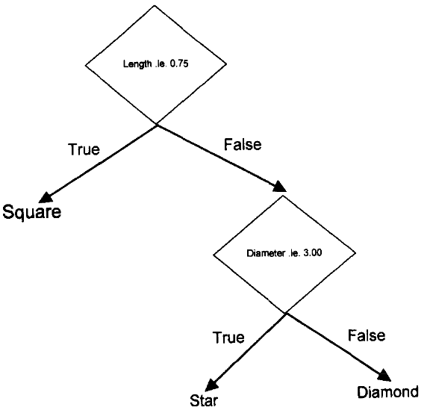
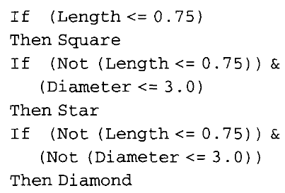
EXAMPLE
A rule may be constructed by forming a conjunct of every test that occurs on a path between the root node and a leaf node of a tree. The collection of all such rules obtained by traversing every unique path from root node to leaf node is a corresponding rule-based solution.

Slide 9
IMPORTANT TERMINOLOGY RELATED TO DECISION TREES
Root Node: It represents the entire population or sample and this further gets divided into two or more homogeneous sets.
Splitting: It is a process of dividing a node into two or more sub-nodes.
Decision Node: When a sub-node splits into further sub-nodes, then it is called the decision node.
Leaf / Terminal Node: Nodes do not split is called Leaf or Terminal node.
Pruning: When we remove sub-nodes of a decision node, this process is called pruning. You can say the opposite process of splitting.
Branch / Sub-Tree: A subsection of the entire tree is called branch or sub-tree.
Parent and Child Node: A node, which is divided into sub-nodes is called a parent node of sub-nodes whereas sub-nodes are the child of a parent node.

Slide 10
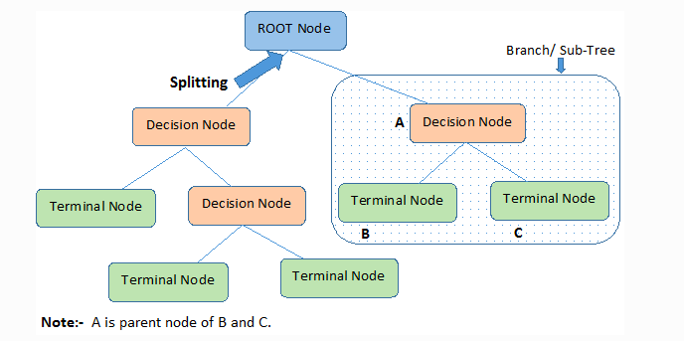
DECISION TREE

Slide 11
ATTRIBUTE SELECTION MEASURES

Slide 12
ATTRIBUTE SELECTION MEASURES
If the dataset consists of N attributes then deciding which attribute to place at the root or at different levels of the tree as internal nodes is a complicated step.
By just randomly selecting any node to be the root can’t solve the issue.
If we follow a random approach, it may give us bad results with low accuracy.
For solving this attribute selection problem, researchers worked and devised some solutions.
They suggested using some criteria like :
Information Gain
Gini index
These criteria will calculate values for every attribute.
The values are sorted, and attributes are placed in the tree by following the order i.e, the attribute with a high value(in case of information gain) is placed at the root.

Slide 13
ATTRIBUTE SELECTION MEASURES
While using Information Gain as a criterion, we assume attributes to be categorical, and for the Gini index, attributes are assumed to be continuous.
These criteria will calculate values for every attribute.
The values are sorted, and attributes are placed in the tree by following the order i.e, the attribute with a high value(in case of information gain) is placed at the root.
While using Information Gain as a criterion, we assume attributes to be categorical, and for the Gini index, attributes are assumed to be continuous.

Slide 14
ATTRIBUTE SELECTION MEASURES
An attribute selection measure is a heuristic for choosing the splitting test that “best” separates a given data partition, D, of class-labeled training tuples into single classes.
If it can split D into smaller partitions as per the results of the splitting criterion, ideally every partition can be pure (i.e., some tuples that fall into a given partition can belong to the same class).
Conceptually, the “best” splitting criterion is the most approximately results in such a method.
Attribute selection measures are called a splitting rules because they decides how the tuples at a given node are to be divided.

Slide 15
ATTRIBUTE SELECTION MEASURES
The attribute selection measure supports a ranking for every attribute defining the given training tuples.
The attribute having the best method for the measure is selected as the splitting attribute for the given tuples.
If the splitting attribute is constant-valued or if it is restricted to binary trees, accordingly, either a split point or a splitting subset should also be decided as an element of the splitting criterion.
The tree node generated for partition D is labelled with the splitting criterion, branches are increase for each result of the criterion, and the tuples are isolated accordingly.
Some famous attribute selection measures inclue:
information gain
gini index

Slide 16
INFORMATION GAIN

Slide 17
INFORMATION GAIN
Information gain is used for deciding the best features/attributes that render maximum data about a class.
It follows the method of entropy while aiming at reducing the level of entropy, starting from the root node to the leaf nodes.
It can be used for feature selection by evaluating the Information gain of each variable in the context of the target variable.
METHOD
Let node N defines or hold the tuples of partition D.
The attribute with the largest information gain is selected as the splitting attribute for node N.
This attribute minimizes the data required to define the tuples in the resulting subdivide and reflects the least randomness or “impurity” in these subdivide.

Slide 18
INFORMATION GAIN
Information gain or IG is a statistical property that measures how well a given attribute separates the training examples according to their target classification.
Constructing a decision tree is all about finding an attribute that returns the highest information gain and the smallest entropy.
Information gain is a decrease in entropy.
It computes the difference between entropy before split and average entropy after split of the dataset based on given attribute values.
ID3 (Iterative Dichotomiser) decision tree algorithm uses information gain.

Slide 19
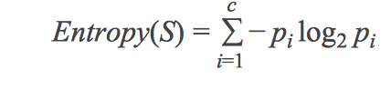
ENTROPY
In machine learning sense and especially in this case Entropy is the measure of homegeneity in the data. Its value is ranges from 0 to 1. Its value is close to 0 if all the example belongs to same class and is close to 1 is there is almost equal split of the data into different classes. Now the formula to calculate entropy is :
Here p_{i} represents the proportion of the data with i^{th} classification and c represents the different types of classification.

Slide 20
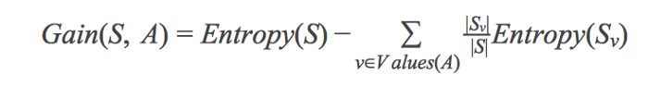
Now Information Gain measure the reduction in entropy by classifying the data on a particular attribute. The formula to calculate Gain by splitting the data on Dataset ‘S’ and on the attribute ‘A’ is :
Here Entropy(S) represents the entropy of the dataset and the second term on the right is the weighted entropy of the different possible classes obtain after the split.
Now the goal is to maximize this information gain.
The attribute which has the maximum information gain is selected as the parent node and successively data is split on the node.

Slide 21
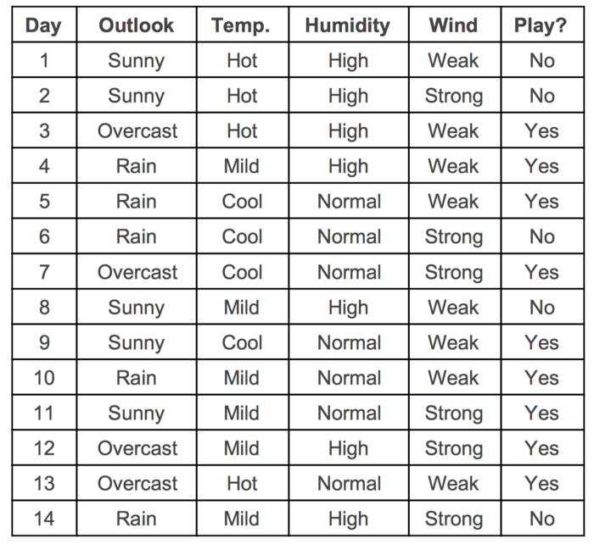
Dataset

Slide 22
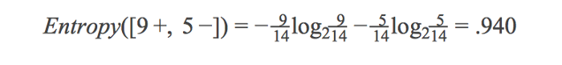
INFORMATION GAIN-EXAMPLE
Entropy of the dataset (Entropy(S)) is :
Now to calculate Information Gain :

Slide 23
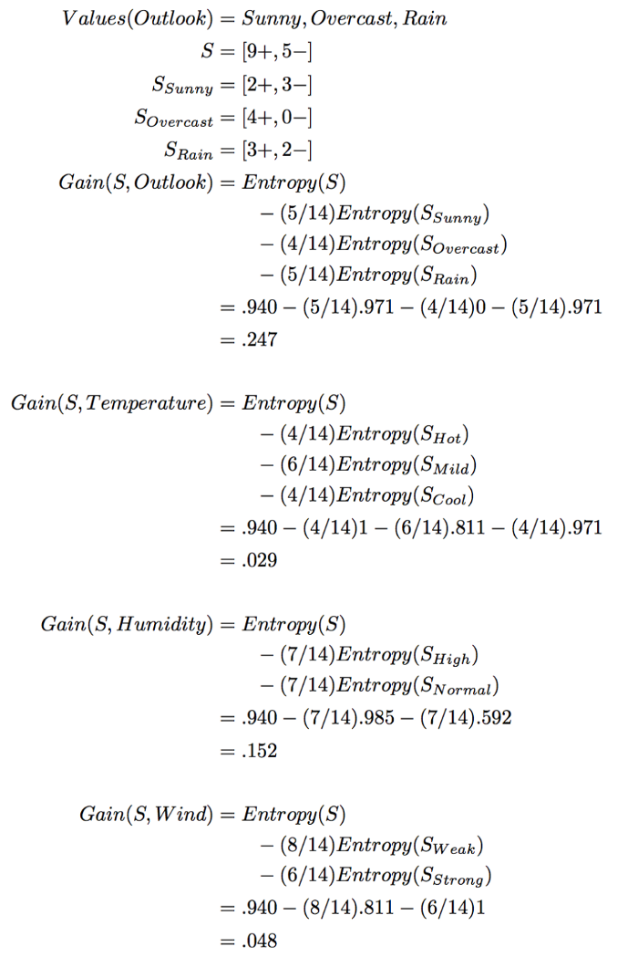
As we can see Outlook attribute has the maximum information gain and hence it is placed at top of the tree.

Slide 24
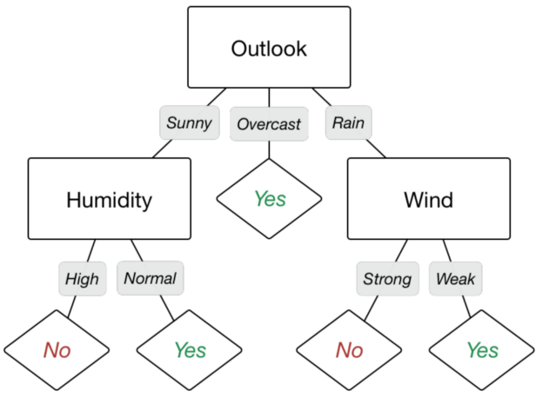
DECISION TREE USING INFORMATION GAIN

Slide 25
GINI INDEX

Slide 26
GINI INDEX
Gini index or Gini impurity measures the degree or probability of a particular variable being wrongly classified when it is randomly chosen.
Gini Index is a score that evaluates how accurate a split is among the classified groups.
Gini index evaluates a score in the range between 0 and 1, where 0 is when all observations belong to one class, and 1 is a random distribution of the elements within classes.
In this case, we want to have a Gini index score as low as possible.
Gini Index is the evaluation metrics we shall use to evaluate our Decision Tree Model.
Gini Index is a metric to measure how often a randomly chosen element would be incorrectly identified.
It means an attribute with lower Gini index should be preferred.

Slide 27
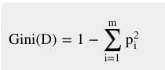
GINI INDEX
The Formula for the calculation of the of the Gini Index is given below.
Where,
p_{i} is the probability that a tuple in D belongs to class C_{i} and
is calculated by |C_{i},_{D}| / |D|.
Note: While building the decision tree, we would prefer choosing the attribute/feature with the least Gini index as the root node.

Slide 28
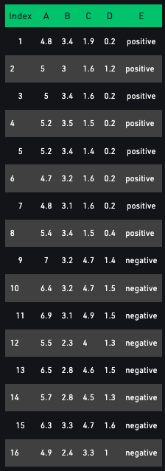
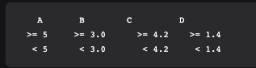
DATASET
In the dataset there are 5 attributes from which attribute E is the predicting feature which contains 2(Positive & Negative) classes.
We have an equal proportion for both the classes. In Gini Index, we have to choose some random values to categorize each attribute.
These values for this dataset are:

Slide 29
Calculating Gini Index for Var A:
Value >= 5: 12
Attribute A >= 5 & class = positive: 5/12
Attribute A >= 5 & class = negative: 7/12
Gini(5, 7) = 1 – [(5/12)² + (7/12)² ] = 0.4860
Value < 5: 4
Attribute A < 5 & class = positive: 3/4
Attribute A < 5 & class = negative : ¼
Gini(3, 1) = 1 – [(3/4)² + (1/4)²] = 0.375
By adding weight and sum each of the gini indices:
Calculating Gini Index for Var B:
Value >= 3: 12 Attribute B >= 3 & class = positive : 8/12
Attribute B >= 5 & class = negative: 4/12
Gini(5, 7) = 1 – [(8/12)² + (4/12)²] =0.4460
Value < 3: 4 Attribute A < 3 & class = positive: 0/4
Attribute A < 3 & class = negative:4/4
Gini(3, 1) = 1 – [(0/4)² + (4/4)² ]
By adding weight and sum each of the gini indices:
Using the same approach we can calculate the Gini index for C and D attributes.

Slide 30
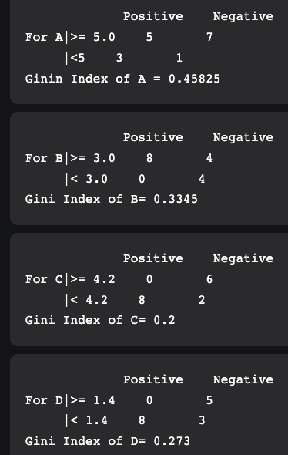
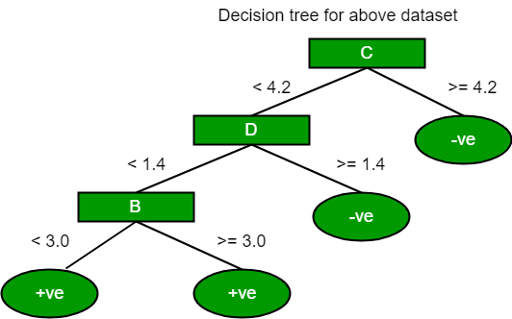
DECISION TREE FOR THE GIVEN DATASET

Slide 31
NOTE:
Gini Index, unlike information gain, isn’t computationally intensive as it doesn’t involve the logarithm function used to calculate entropy in information gain.
Therefore, Gini Index is preferred over Information gain.

Slide 32
STRENGTHS AND WEAKNESSES OF THE DECISION TREE APPROACH

Slide 33
The weaknesses of decision tree methods :
Decision trees are less appropriate for estimation tasks where the goal is to predict the value of a continuous attribute.
Decision trees are prone to errors in classification problems with many classes and a relatively small number of training examples.
Decision tree can be computationally expensive to train. The process of growing a decision tree is computationally expensive. At each node, each candidate splitting field must be sorted before its best split can be found. In some algorithms, combinations of fields are used and a search must be made for optimal combining weights. Pruning algorithms can also be expensive since many candidate sub-trees must be formed and compared.
The strengths of decision tree methods are:
Decision trees are able to generate understandable rules.
Decision trees perform classification without requiring much computation.
Decision trees are able to handle both continuous and categorical variables.
Decision trees provide a clear indication of which fields are most important for prediction or classification.

Slide 34
ID3

Slide 35
ITERATIVE DICHOTOMISER 3 (ID3)
ID3 algorithm, stands for Iterative Dichotomiser 3, is a classification algorithm that follows a greedy approach of building a decision tree by selecting a best attribute that yields maximum Information Gain (IG) or minimum Entropy (H).
ID3 algorithm uses Information Gain to decide which attribute is to be used to classify the current subset of the data.
For each level of the tree, information gain is calculated for the remaining data recursively.

Slide 36
Here we will see the ID3 algorithm to build a decision tree based on a weather data and illustrate how we can use this procedure to make a decision on an action (like whether to play outside) based on the current data using the previously collected data.
The steps in ID3 algorithm are as follows:
Calculate entropy for dataset.
For each attribute/feature. 2.1. Calculate entropy for all its categorical values. 2.2. Calculate information gain for the feature.
Find the feature with maximum information gain.
Repeat it until we get the desired tree.

Slide 37
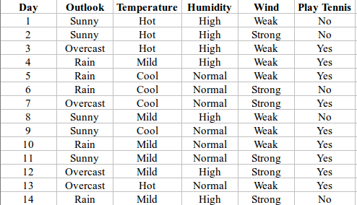
Here, dataset is of binary classes(yes and no), where 9 out of 14 are "yes" and 5 out of 14 are "no".
Complete entropy of dataset is:
H(S) = - p(yes) * log2(p(yes)) - p(no) * log2(p(no))
= - (9/14) * log2(9/14) - (5/14) * log2(5/14)
= - (-0.41) - (-0.53) = 0.94

Slide 38
First Attribute – Outlook
Categorical values - sunny, overcast and rain H(Outlook=sunny) = -(2/5)*log(2/5) -(3/5)*log(3/5)
=0.971
H(Outlook=rain) = -(3/5)*log(3/5)-(2/5)*log(2/5) =0.971
H(Outlook=overcast) = -(4/4)*log(4/4)-0 = 0
Average Entropy Information for Outlook –
I(Outlook) = p(sunny) * H(Outlook=sunny) + p(rain) * H(Outlook=rain) + p(overcast) * H(Outlook=overcast)
= (5/14)*0.971 + (5/14)*0.971 + (4/14)*0 = 0.693
Information Gain = H(S) - I(Outlook) = 0.94 - 0.693 = 0.247

Slide 39
Second Attribute - Temperature
Categorical values - hot, mild, cool
H(Temperature=hot) = -(2/4)*log(2/4)-(2/4)*log(2/4) = 1
H(Temperature=cool) = -(3/4)*log(3/4)-(1/4)*log(1/4) = 0.811
H(Temperature=mild) = -(4/6)*log(4/6)-(2/6)*log(2/6) = 0.9179
Average Entropy Information for Temperature - I(Temperature) = p(hot)*H(Temperature=hot) + p(mild)*H(Temperature=mild) + p(cool)*H(Temperature=cool) = (4/14)*1 + (6/14)*0.9179 + (4/14)*0.811 = 0.9108
Information Gain = H(S) - I(Temperature) = 0.94 - 0.9108 = 0.0292
Third Attribute - Humidity
Categorical values - high, normal
H(Humidity=high) = -(3/7)*log(3/7)-(4/7)*log(4/7) = 0.983
H(Humidity=normal) = -(6/7)*log(6/7)-(1/7)*log(1/7) = 0.591
Average Entropy Information for Humidity - I(Humidity) = p(high)*H(Humidity=high) + p(normal)*H(Humidity=normal) = (7/14)*0.983 + (7/14)*0.591 = 0.787
Information Gain = H(S) - I(Humidity) = 0.94 - 0.787 = 0.153

Slide 40
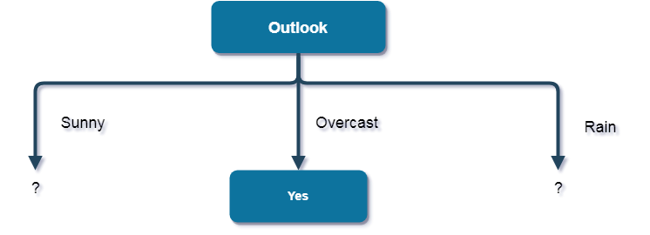
Here, the attribute with maximum information gain is Outlook. So, the decision tree built so far -
Fourth Attribute - Wind
Categorical values - weak, strong
H(Wind=weak) = -(6/8)*log(6/8)-(2/8)*log(2/8) = 0.811
H(Wind=strong) = -(3/6)*log(3/6)-(3/6)*log(3/6) = 1
Average Entropy Information for Wind –
I(Wind) = p(weak)*H(Wind=weak) + p(strong)*H(Wind=strong) = (8/14)*0.811 + (6/14)*1 = 0.892
Information Gain = H(S) - I(Wind) = 0.94 - 0.892 = 0.048
Here, when Outlook == overcast, it is of pure class(Yes).
Now, we have to repeat same procedure for the data with rows consist of Outlook value as Sunny and then for Outlook value as Rain.

Slide 41
First Attribute - Temperature
Categorical values - hot, mild, cool
H(Sunny, Temperature=hot) = -0-(2/2)*log(2/2) = 0
H(Sunny, Temperature=cool) = -(1)*log(1)- 0 = 0 H(Sunny, Temperature=mild) = -(1/2)*log(1/2)-(1/2)*log(1/2) = 1
Average Entropy Information for Temperature –
I(Sunny, Temperature) = p(Sunny, hot)*H(Sunny, Temperature=hot) + p(Sunny, mild)*H(Sunny, Temperature=mild) + p(Sunny, cool)*H(Sunny, Temperature=cool) = (2/5)*0 + (1/5)*0 + (2/5)*1 = 0.4
Information Gain = H(Sunny) - I(Sunny, Temperature) = 0.971 - 0.4 = 0.571
Now, finding the best attribute for splitting the data with Outlook=Sunny values{ Dataset rows = [1, 2, 8, 9, 11]}.
Complete entropy of Sunny is –
H(S) = - p(yes) * log2(p(yes)) - p(no) * log2(p(no)) = - (2/5) * log2(2/5) - (3/5) * log2(3/5) = 0.971

Slide 42
Second Attribute - Humidity
Categorical values - high, normal
H(Sunny, Humidity=high) = - 0 - (3/3)*log(3/3) = 0
H(Sunny, Humidity=normal) = -(2/2)*log(2/2)-0 = 0
Average Entropy Information for Humidity –
I(Sunny, Humidity) = p(Sunny, high)*H(Sunny, Humidity=high) + p(Sunny, normal)*H(Sunny, Humidity=normal) = (3/5)*0 + (2/5)*0 = 0
Information Gain = H(Sunny) - I(Sunny, Humidity) = 0.971 - 0 = 0.971
Third Attribute – Wind
Categorical values - weak, strong
H(Sunny, Wind=weak) = -(1/3)*log(1/3)-(2/3)*log(2/3) = 0.918
H(Sunny, Wind=strong) = -(1/2)*log(1/2)-(1/2)*log(1/2) = 1
Average Entropy Information for Wind - I(Sunny, Wind) = p(Sunny, weak)*H(Sunny, Wind=weak) + p(Sunny, strong)*H(Sunny, Wind=strong) = (3/5)*0.918 + (2/5)*1 = 0.9508
Information Gain = H(Sunny) - I(Sunny, Wind) = 0.971 - 0.9508 = 0.0202

Slide 43
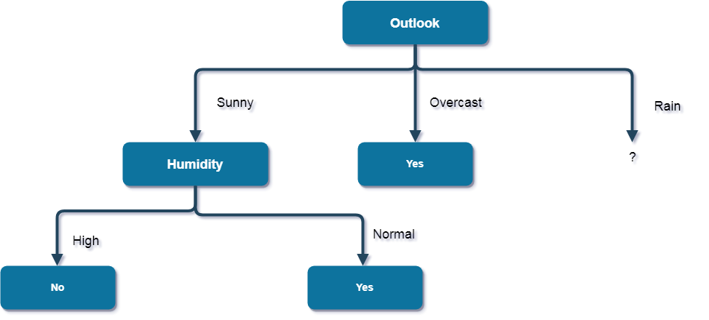
Here, the attribute with maximum information gain is Humidity. So, the decision tree built so far -
Here, when Outlook = Sunny and Humidity = High, it is a pure class of category "no".
And When Outlook = Sunny and Humidity = Normal, it is again a pure class of category "yes".
Therefore, we don't need to do further calculations.

Slide 44
First Attribute – Temperature
Categorical values - mild, cool
H(Rain, Temperature=cool) = -(1/2)*log(1/2)- (1/2)*log(1/2) = 1
H(Rain, Temperature=mild) = -(2/3)*log(2/3)-(1/3)*log(1/3) = 0.918
Average Entropy Information for Temperature –
I(Rain, Temperature) = p(Rain, mild)*H(Rain, Temperature=mild) + p(Rain, cool)*H(Rain, Temperature=cool) = (2/5)*1 + (3/5)*0.918 = 0.9508
Information Gain = H(Rain) - I(Rain, Temperature) = 0.971 - 0.9508 = 0.0202
Now, finding the best attribute for splitting the data with
Outlook=Sunny values{ Dataset rows = [4, 5, 6, 10, 14]}.
Complete entropy of Rain is –
H(S) = - p(yes) * log2(p(yes)) - p(no) * log2(p(no)) = - (3/5) * log(3/5) - (2/5) * log(2/5) = 0.971

Slide 45
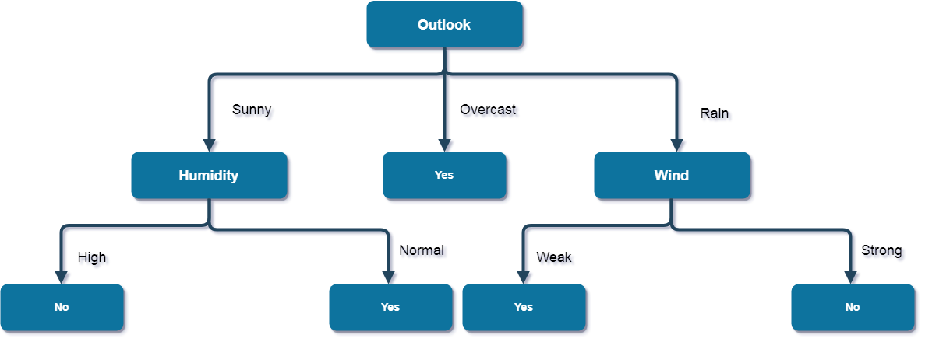
Here, the attribute with maximum information gain is Wind. So, the decision tree built so far -
Second Attribute - Wind
Categorical values - weak, strong
H(Wind=weak) = -(3/3)*log(3/3)-0 = 0
H(Wind=strong) = 0-(2/2)*log(2/2) = 0
Average Entropy Information for Wind –
I(Wind) = p(Rain, weak)*H(Rain, Wind=weak) + p(Rain, strong)*H(Rain, Wind=strong) = (3/5)*0 + (2/5)*0 = 0
Information Gain = H(Rain) - I(Rain, Wind) = 0.971 - 0 = 0.971
Here, when Outlook = Rain and Wind = Strong, it is a pure class of category "no".
And When Outlook = Rain and Wind = Weak, it is again a pure class of category "yes". And this is our final desired tree for the given dataset.

Slide 46
CHARACTERISTICS OF ID3 ALGORITHM
Characteristics of ID3 Algorithm are as follows:
ID3 uses a greedy approach that's why it does not guarantee an optimal solution; it can get stuck in local optimums.
ID3 can overfit to the training data (to avoid overfitting, smaller decision trees should be preferred over larger ones).
This algorithm usually produces small trees, but it does not always produce the smallest possible tree.
ID3 is harder to use on continuous data (if the values of any given attribute is continuous, then there are many more places to split the data on this attribute, and searching for the best value to split by can be time consuming).

Slide 47
DISTANCE BASED CLASSIFICATION

Slide 48
DISTANCE BASED CLASSIFICATION
Distance-based algorithms are nonparametric methods that can be used for classification.
These algorithms classify objects by the dissimilarity between them as measured by distance functions.
Several candidate distance functions are reviewed in this chapter along with two particular classification algorithms.
Distance measures play an important role in machine learning
They provide the foundations for many popular and effective machine learning algorithms like KNN (K-Nearest Neighbours) for supervised learning and K-Means clustering for unsupervised learning.

Slide 49
DISTANCE BASED CLASSIFICATION
Different distance measures must be chosen and used depending on the types of data.
As such, it is important to know how to implement and calculate a range of different popular distance measures and the intuitions for the resulting scores.
Various types of distance measures in machine learning are:
Hamming Distance
Euclidean Distance
Manhattan Distance (Taxiable or City Block)
Minkowski Distance
Mahalanobis Distance
Cosine Similarity

Slide 50
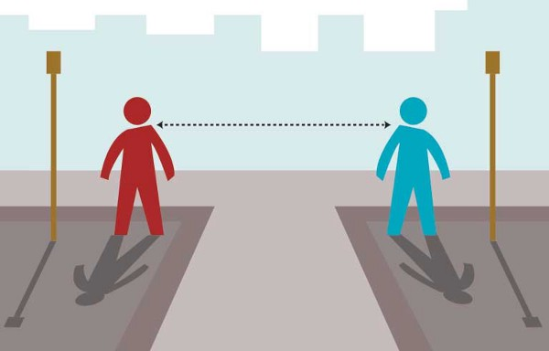
ROLE OF DISTANCE MEASURES
Distance measures play an important role in machine learning
A distance measure is an objective score that summarizes the relative difference between two objects in a problem domain.
Most commonly, the two objects are rows of data that describes a subject (such as a person, car, or house), or an event (such as purchases, a claim, or a diagnosis)

Slide 51
NEAREST NEIGHBOUR

Slide 52
NEAREST NEIGHBOUR
Nearest neighbour classification is a machine learning method that aims at labelling previously unseen query objects while distinguishing two or more destination classes.
As any classifier, in general, it requires some training data with given labels and, thus, is an instance of supervised learning.
In the simplest variant, the query object inherits the label from the closest sample object in the training set.
Common variants extend the decision set from the single nearest neighbour within the training data to the set of k nearest neighbours for any k > 1.

Slide 53
K NEAREST NEIGHBOUR (KNN)
Knn is a non-parametric supervised learning technique in which we try to classify the data point to a given category with the help of training set.
In simple words, it captures information of all training cases and classifies new cases based on a similarity.

Slide 54
KNN (EXAMPLE)
Height (in cms) | Weight (in kgs) | T Shirt Size
158 | 58 | M
158 | 59 | M
158 | 63 | M
160 | 59 | M
160 | 60 | M
163 | 60 | M
163 | 61 | M
160 | 64 | L
163 | 64 | L
165 | 61 | L
165 | 62 | L
165 | 65 | L
168 | 62 | L
168 | 63 | L
168 | 66 | L
170 | 63 | L
170 | 64 | L
170 | 68 | L
Suppose we have height, weight and T-shirt size of some customers and we need to predict the T-shirt size of a new customer given only height and weight information we have. Data including height, weight and T-shirt size information is shown in the table.
New customer named 'Monica' has height 161cm and weight 61kg. Predict the T-shirt size for Monica using KNN method.

Slide 55
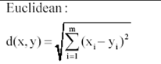
SOLUTION
Step 1 : Calculate Similarity based on distance function There are many distance functions but Euclidean is the most commonly used measure.
It is mainly used when data is continuous.
The idea to use distance measure is to find the distance (similarity) between new sample and training cases and then finds the k-closest customers to new customer in terms of height and weight.
Euclidean distance between first observation and new observation (monica) is as follows - =SQRT((161-158)^2+(61-58)^2)
Similarly, we will calculate distance of all the training cases with new case and calculates the rank in terms of distance. The smallest distance value will be ranked 1 and considered as nearest neighbour.

Slide 56
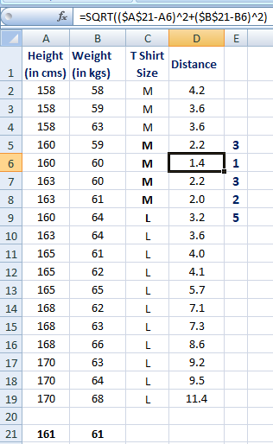
SOLUTION
Step 2 : Find K-Nearest Neighbors Let k be 5. Then the algorithm searches for the 5 customers closest to Monica, i.e. most similar to Monica in terms of attributes, and see what categories those 5 customers were in.
If 4 of them had ‘Medium T shirt sizes’ and 1 had ‘Large T shirt size’ then your best guess for Monica is ‘Medium T shirt.
See the calculation shown in the snapshot.

Slide 57
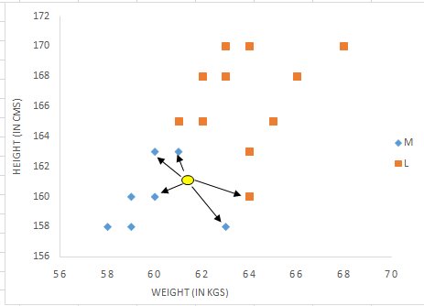
SOLUTION
In the graph below, binary dependent variable (T-shirt size) is displayed in blue and orange color.
'Medium T-shirt size' is in blue color and 'Large T-shirt size' in orange color.
New customer information is exhibited in yellow circle.
Four blue highlighted data points and one orange highlighted data point are close to yellow circle.
So, the prediction for the new case is blue highlighted data point which is Medium T-shirt size.
kNN visual representation

Slide 58
SUPPORT VECTOR MACHINE

Slide 59
SUPPORT VECTOR MACHINE
Support Vector Machine or SVM is one of the most popular Supervised Learning algorithms, which is used for Classification as well as Regression problems.
However, primarily, it is used for Classification problems in Machine Learning.
The goal of the SVM algorithm is to create the best line or decision boundary that can segregate n-dimensional space into classes so that we can easily put the new data point in the correct category in the future.
This best decision boundary is called a hyperplane.
SVM chooses the extreme points/vectors that help in creating the hyperplane.
These extreme cases are called as support vectors, and hence algorithm is termed as Support Vector Machine.

Slide 60

SUPPORT VECTOR MACHINE
Consider the diagram here in which there are two different categories that are classified using a decision boundary or hyperplane.

Slide 61
SUPPORT VECTOR MACHINE
Suppose we see a strange cat that also has some features of dogs, so if we want a model that can accurately identify whether it is a cat or dog, so such a model can be created by using the SVM algorithm.
We will first train our model with lots of images of cats and dogs so that it can learn about different features of cats and dogs, and then we test it with this strange creature.
So as support vector creates a decision boundary between these two data (cat and dog) and choose extreme cases (support vectors), it will see the extreme case of cat and dog.
On the basis of the support vectors, it will classify it as a cat. Play Video

Slide 62
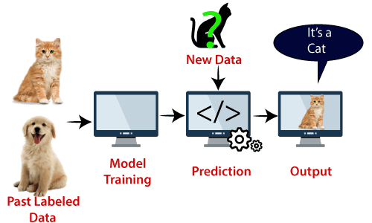
SUPPORT VECTOR MACHINE
Consider the diagram:
Note:
SVM algorithm can be used for Face detection, image classification, text categorization, etc.

Slide 63
TYPES OF SVM
SVM can be of two types:
Linear SVM: Linear SVM is used for linearly separable data, which means if a dataset can be classified into two classes by using a single straight line, then such data is termed as linearly separable data, and classifier is used called as Linear SVM classifier.
Non-linear SVM: Non-Linear SVM is used for non-linearly separated data, which means if a dataset cannot be classified by using a straight line, then such data is termed as non-linear data and classifier used is called as Non-linear SVM classifier.

Slide 64
HYPERPLANE AND SUPPORT VECTORS IN THE SVM ALGORITHM
Hyperplane:
There can be multiple lines/decision boundaries to segregate the classes in n-dimensional space, but we need to find out the best decision boundary that helps to classify the data points. This best boundary is known as the hyperplane of SVM.
The dimensions of the hyperplane depend on the features present in the dataset, which means if there are 2 features , then hyperplane will be a straight line. And if there are 3 features, then hyperplane will be a 2-dimension plane.
We always create a hyperplane that has a maximum margin, which means the maximum distance between the data points.
Support Vectors:
The data points or vectors that are the closest to the hyperplane and which affect the position of the hyperplane are termed as Support Vector. Since these vectors support the hyperplane, hence called a Support vector.

Slide 65
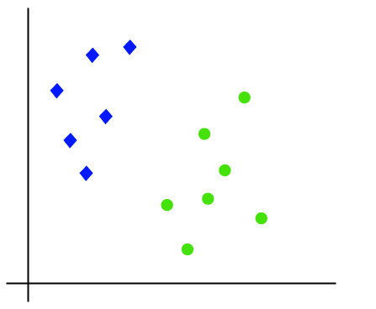
LINEAR SVM
The working of the SVM algorithm can be understood by using an example.
Suppose we have a dataset that has two tags (green and blue), and the dataset has two features x1 and x2.
We want a classifier that can classify the pair(x1, x2) of coordinates in either green or blue. Consider the image here:

Slide 66
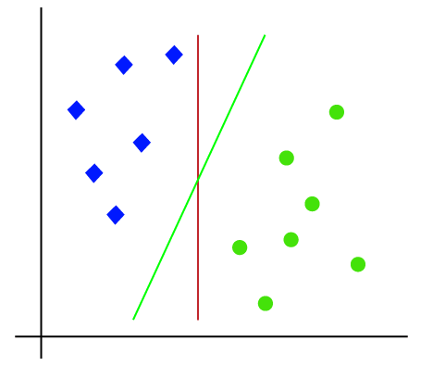
LINEAR SVM
So, as it is 2-d space so by just using a straight line, we can easily separate these two classes.
But there can be multiple lines that can separate these classes.
Consider the image here:

Slide 67
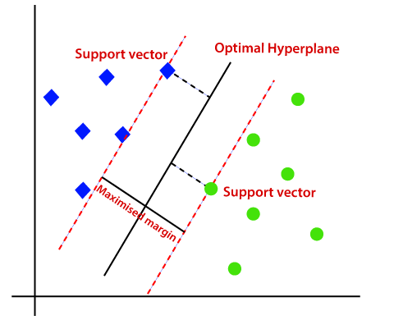
LINEAR SVM
Hence, the SVM algorithm helps to find the best line or decision boundary; this best boundary or region is called as a hyperplane.
SVM algorithm finds the closest point of the lines from both the classes.
These points are called support vectors.
The distance between the vectors and the hyperplane is called as margin.
And the goal of SVM is to maximize this margin.
The hyperplane with maximum margin is called the optimal hyperplane.

Slide 68
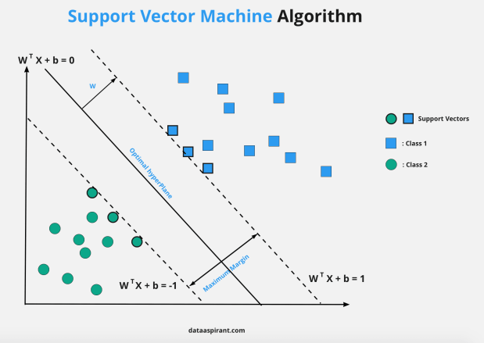

Slide 69
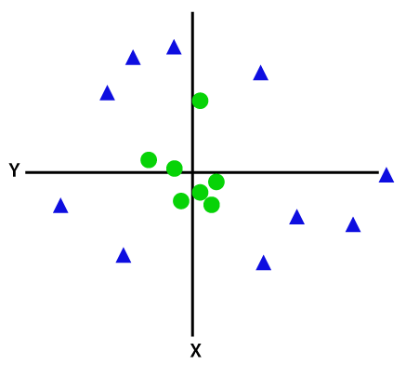
NON-LINEAR SVM
If data is linearly arranged, then we can separate it by using a straight line, but for non-linear data, we cannot draw a single straight line.
Consider the image given here.
To separate these data points, we need to add one more dimension.
For linear data, we have used two dimensions x and y, so for non-linear data, we will add a third dimension z.
It can be calculated as:
z=x² +y²

Slide 70
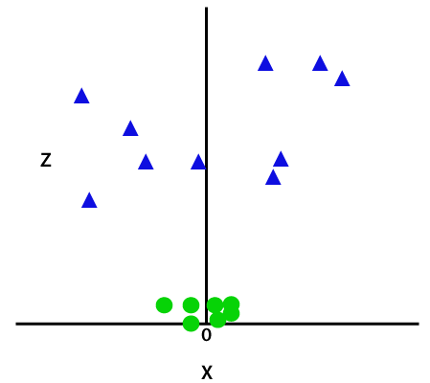
NON-LINEAR SVM
By adding the third dimension, the sample space will become as shown here in the image.

Slide 71
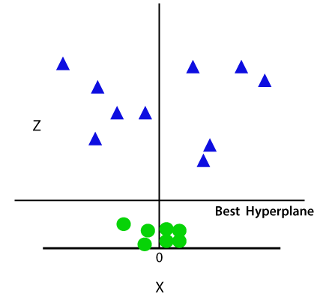
NON-LINEAR SVM
So now, SVM will divide the datasets into classes in the following way. Consider the image shown here.

Slide 72
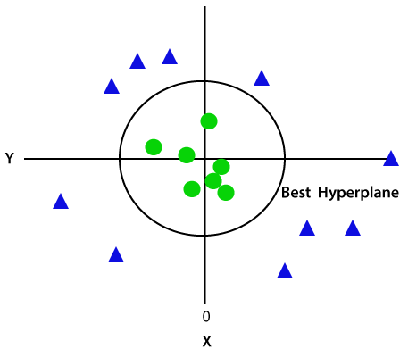
NON-LINEAR SVM
Since we are in 3-d Space, hence it is looking like a plane parallel to the x-axis.
If we convert it in 2d space with z=1, then it will become as shown in the figure.
Hence, we get a circumference of radius 1 in case of non-linear data.

Slide 73
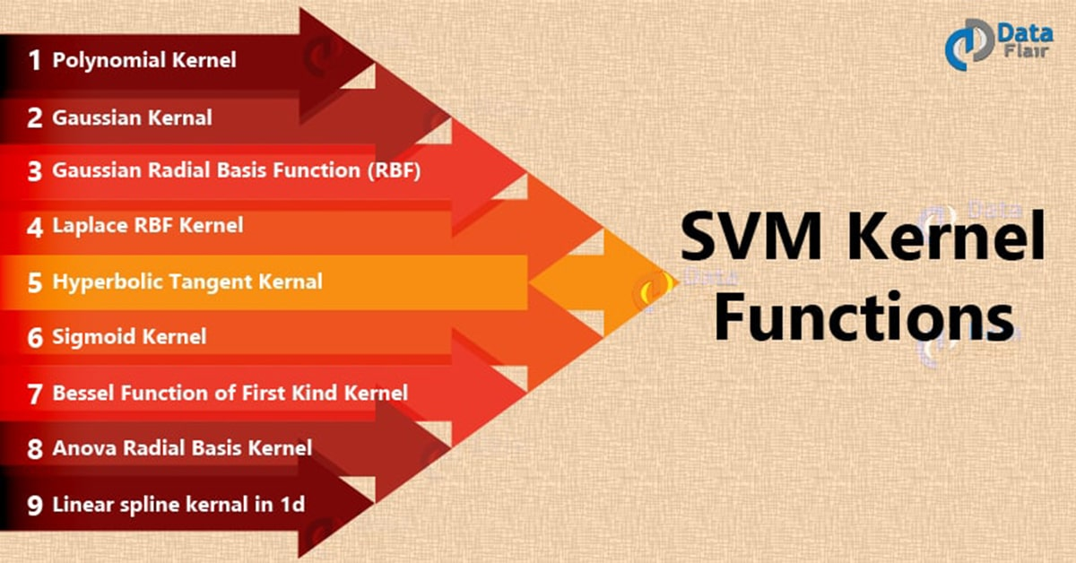
SVM KERNEL

Slide 74
SVM KERNEL FUNCTIONS
SVM algorithms use a set of mathematical functions that are defined as the kernel.
The function of kernel is to take data as input and transform it into the required form.
Different SVM algorithms use different types of kernel functions.
These functions can be different types. For example linear, nonlinear, polynomial, radial basis function (RBF), and sigmoid.
Kernel functions fare also used for sequence data, graphs, text, images, as well as vectors.
The most used type of kernel function is RBF. Because it has localized and finite response along the entire x-axis.
The kernel functions return the inner product between two points in a suitable feature space.
Thus by defining a notion of similarity, with little computational cost even in very high-dimensional spaces.

Slide 75
MOST IMPORTANT SVM PARAMETERS
kernel: the kernel type to be used. The most common kernels are rbf (this is the default value), poly or sigmoid, but you can also create your own kernel.
C: this is the regularization parameter described in the Tuning Parameters section
gamma: this was also described in the Tuning Parameters section
degree: it is used only if the chosen kernel is poly and sets the degree of the polinom
probability: this is a boolean parameter and if it’s true, then the model will return for each prediction, the vector of probabilities of belonging to each class of the response variable. So basically it will give you the confidences for each prediction.
shrinking: this shows whether or not you want a shrinking heuristic used in your optimization of the SVM, which is used in Sequential Minimal Optimization. It’s default value is true, an if you don’t have a good reason, please don’t change this value to false, because shrinking will greatly improve your performance, for very little loss in terms of accuracy in most cases.

Slide 76
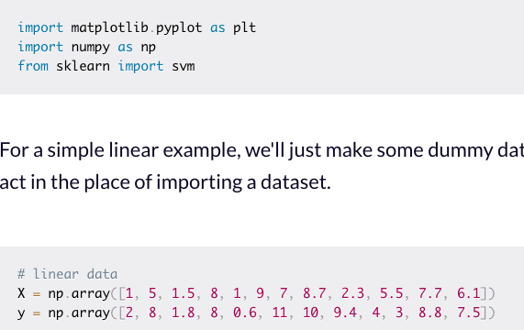
LINEAR SVM EXAMPLE (PYTHON)
We'll start by importing a few libraries that will make it easy to work with most machine learning projects.
For a simple linear example, we'll just make some dummy data and that will act in the place of importing a dataset.

Slide 77
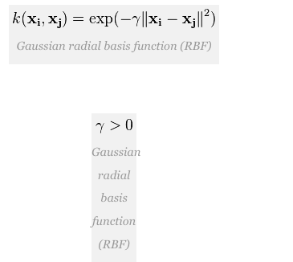
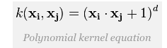
EXAMPLES OF SVM KERNELS
1. Polynomial kernel
It is popular in image processing.
Equation is:
where d is the degree of the polynomial.
2. Radial basis function (RBF)
It is a general-purpose kernel; used when there is no prior knowledge about the data. Equation is:
Where,

Slide 78
EXAMPLES OF SVM KERNELS
3. Linear Kernel
It is the most basic type of kernel, usually one dimensional in nature. It proves to be the best function when there are lots of features. The linear kernel is mostly preferred for text-classification problems as most of these kinds of classification problems can be linearly separated.
Linear kernel functions are faster than other functions.
Linear Kernel Formula
F(x, xj) = sum( x.xj)
Here, x, xj represents the data you’re trying to classify.
4. Sigmoid Kernel
It is mostly preferred for neural networks.
This kernel function is similar to a two-layer perceptron model of the neural network, which works as an activation function for neurons.
It can be shown as,
Sigmoid Kenel Function:
F(x, xj) = tanh(αxay + c)

Slide 79
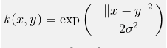
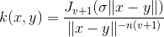
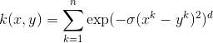
EXAMPLES OF SVM KERNELS
5. Gaussian Kernel
It is a commonly used kernel. It is used when there is no prior knowledge of a given dataset.
Gaussian Kernel Formula
6. Bessel function kernel
It is mainly used for removing the cross term in mathematical functions.
Bassel Kernel Formula
Here J is the Bessel function.
7. ANOVA kernel
It is also known as a radial basis function kernel. It usually performs well in multidimensional regression problems.
Anova Kernel Formula

Slide 80
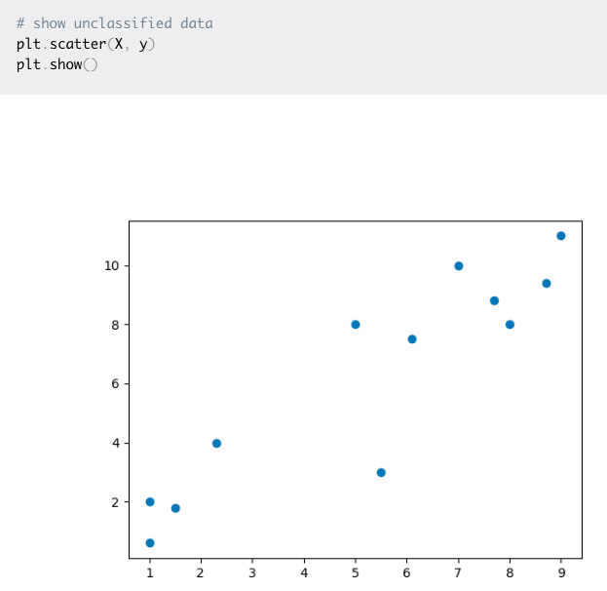
LINEAR SVM EXAMPLE (PYTHON)
The reason we're working with numpy arrays is to make the matrix operations faster because they use less memory than Python lists.
You could also take advantage of typing the contents of the arrays. Now let's take a look at what the data look like in a plot:

Slide 81
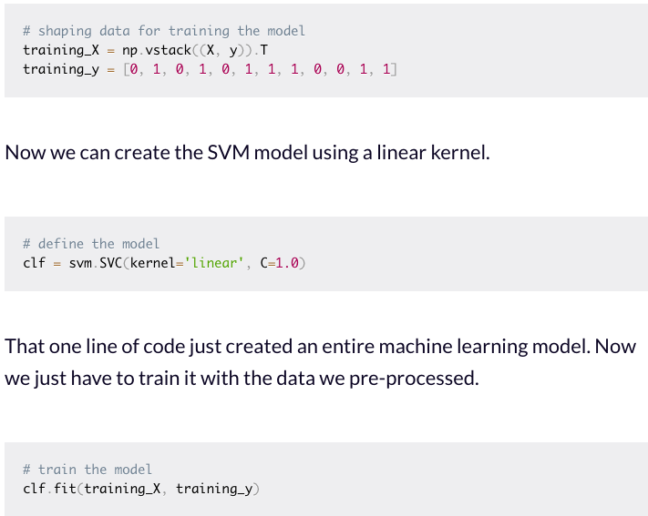
LINEAR SVM EXAMPLE (PYTHON)
We'll do a bit of pre-processing on the already structured code. This will put the raw data into a format that we can use to train the SVM model.
Now we can create the SVM model using a linear kernel.
That one line of code just created an entire machine learning model.

Slide 82
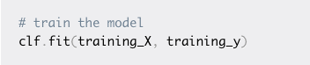
LINEAR SVM EXAMPLE (PYTHON)
Now we just have to train it with the data we pre-processed.
That's how you can build a model for any machine learning project.
The dataset we have might be small, but if you encounter a real-world dataset that can be classified with a linear boundary this model still works.
With your model trained, you can make predictions on how a new data point will be classified and you can make a plot of the decision boundary.

Slide 83
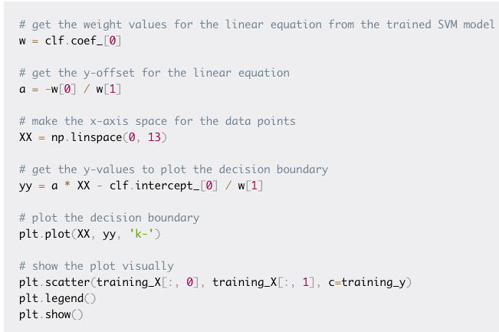
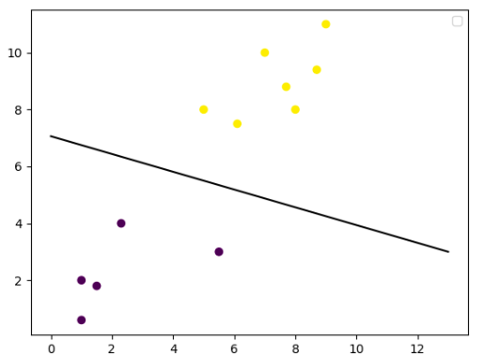
LINEAR SVM EXAMPLE (PYTHON)
Let's plot the decision boundary.

Slide 84
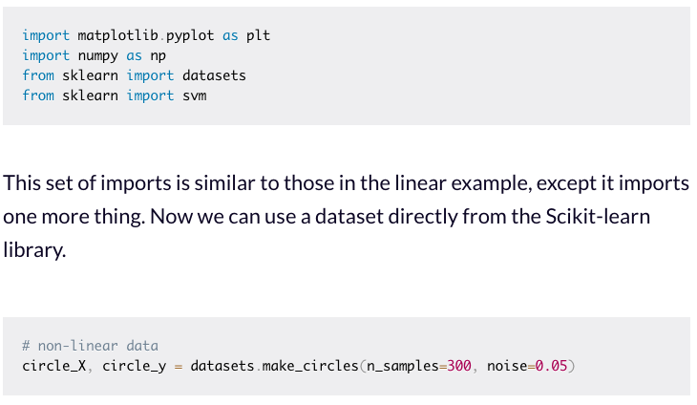
NON-LINEAR SVM EXAMPLE (PYTHON)
For this example, we'll use a slightly more complicated dataset to show one of the areas SVMs shine in. Let's import some packages.
This set of imports is similar to those in the linear example, except it imports one more thing. Now we can use a dataset directly from the Scikit-learn library.

Slide 85
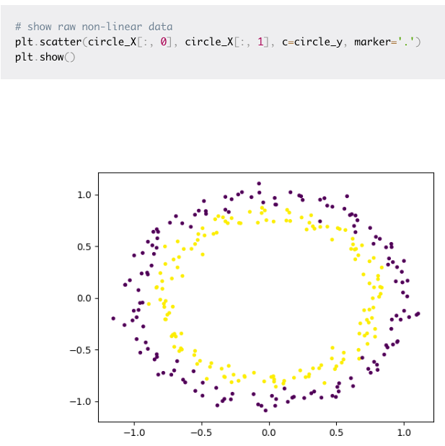
NON-LINEAR SVM EXAMPLE (PYTHON)
The next step is to take a look at what this raw data looks like with a plot.

Slide 86
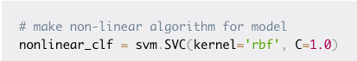
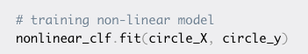
NON-LINEAR SVM EXAMPLE (PYTHON)
Here's how the SVM model will look for this:
In this case, we'll go with an RBF (Gaussian Radial Basis Function) kernel to classify this data.
Now it's time to train the model.

Slide 87
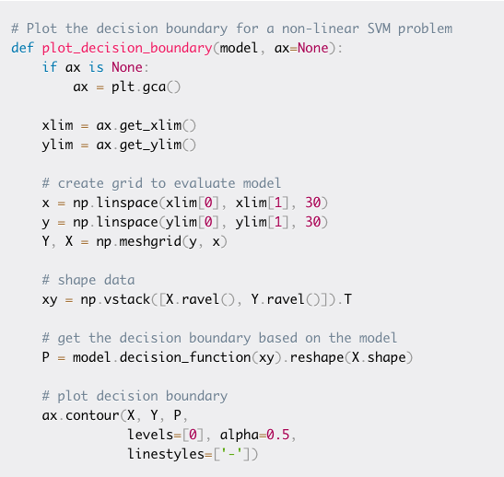
NON-LINEAR SVM EXAMPLE (PYTHON)
You can start labelling new data in the correct category based on this model.
To see what the decision boundary looks like, we'll have to make a custom function to plot it.

Slide 88
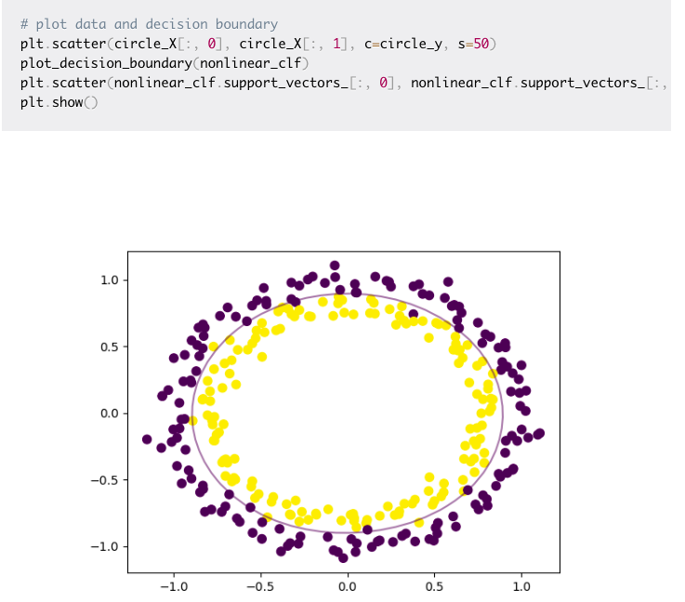

You have everything you need to plot the decision boundary for this non-linear data.
We can do that with a few lines of code that use the Matlibplot library, just like the other plots.

Slide 89
PROS AND CONS OF SVM
Pros
SVM can be very efficient, because it uses only a subset of the training data, only the support vectors
Works very well on smaller data sets, on non-linear data sets and high dimensional spaces
Is very effective in cases where number of dimensions is greater than the number of samples
It can have high accuracy, sometimes can perform even better than neural networks
Not very sensitive to overfitting
Cons
Training time is high when we have large data sets
When the data set has more noise (i.e., target classes are overlapping) SVM doesn’t perform well

